Slide 1
JavaFX: Introduction
JDBC: Introduction
P-000

Slide 2
What is JavaFX
JavaFX is a set of graphics and media packages that enable developers to design, create, test, debug, and deploy rich client applications that operate consistently across diverse platforms.
It's a Java-based framework for building desktop applications, mobile applications, and rich internet applications (RIAs) that can run on various devices.
JavaFX provides a rich set of APIs for creating user interfaces (UIs) with modern features

Slide 3
Some Important Key Features of JavaFX
FXML: A XML-based markup language for defining user interfaces.
Scene Graph: A hierarchical tree structure for organizing graphical elements.
CSS Styling: Ability to style UI components using Cascading Style Sheets (CSS).
Event Handling: Mechanisms for handling user input events such as mouse clicks and key presses.
Media Support: APIs for playing audio and video files.
Animation: Support for creating animations and transitions.
3D Graphics: APIs for creating 3D graphics and visualizations.

Slide 4
Installation and IDE
We will use IntelliJ (https://www.jetbrains.com/idea/download/) as our IDE to write the program. It provides great support to compile and run the program along with getting intelligent suggestions.
The first set of instructions to download (Java SDK -> JavaFX SDK -> Setting Up a Project and Necessary Paths) [https://openjfx.io/openjfx-docs/]
There are various ways to build and run a Java project: Maven, Gradle, Non-modular, etc. You can find those in the previous link. These help to resolve dependencies, compile, run, test and package the applications.

Slide 5
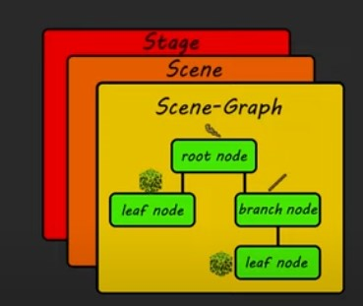
Components of JavaFX
Stage (Main Window): The Stage is the top-level container or window in a JavaFX application.
Scene (Content Area): The Scene is a container for all the content in a JavaFX application.
Root Node: The root node is the top-level node in the scene graph hierarchy. It serves as the parent for all other nodes added to the scene. Common root node types include Pane subclasses such as StackPane, BorderPane, GridPane, etc.
Leaf Node: Leaf nodes are the individual graphical elements or components added to the scene. For example - shapes (e.g., Rectangle, Circle, Polygon), text (e.g., Text, Label), controls (e.g., Button, TextField, ComboBox), images, media players, etc. Leaf nodes are typically added as children of the root node or other parent nodes in the scene graph hierarchy.

Slide 6
import javafx.application.Application;
import javafx.scene.Scene;
import javafx.scene.control.Button;
import javafx.scene.layout.StackPane;
import javafx.stage.Stage;
public class BasicJavaFXApp extends Application {
@Override
public void start(Stage primaryStage) {
// Create a button
Button button = new Button("Click me!");
// Create a layout pane (StackPane) and add the button to it
StackPane root = new StackPane();
root.getChildren().add(button);
// Create a scene with the layout pane as its root
Scene scene = new Scene(root, 300, 200);
// Set the scene on the primary stage
primaryStage.setScene(scene);
// Set the title of the stage
primaryStage.setTitle("Basic JavaFX App");
// Show the stage
primaryStage.show();
}
public static void main(String[] args) {
// Launch the JavaFX application
launch(args);
}
}
A Basic Application Example and Components to Discuss

Slide 7
Working With Basic Shapes

Slide 8
public class HelloApplication extends Application {
@Override
public void start(Stage stage) throws IOException {
Group root = new Group();
Scene scene = new Scene(root, 600, 600);
//Stage stage = new Stage();
Text text = new Text();
text.setText("Hello drawing shape");
text.setX(100);
text.setY(50);
text.setFont(Font.font("Cambria", 50));
Line line = new Line();
line.setStartX(300);
line.setStartY(300);
line.setEndX(450);
line.setEndY(450);
root.getChildren().add(line);
root.getChildren().add(text);
stage.setScene(scene);
stage.show();
}
public static void main(String[] args) {
launch(args);
}
}
Working With Basic Shapes

Slide 9
Using Scene Builder to Easily Design UI
Scene Builder provides drag and drop feature
It automatically generates the FXML which defines the layout of a project
(https://gluonhq.com/products/scene-builder/)
Add the executable on Settings-> Language & Frameworks -> Add the path to scene builder exe
Use SceneBuilder to open your fxml file. Dragging and dropping the features would automatically update the fxml file

Slide 10
Update the reading of the root node
Parent root = FXMLLoader.load(getClass().getResource("hello-view.fxml"));
[Root will get its children nodes’ information from this FXMLLoader]

Slide 11
Event Handling
What is Event Handling?
Event handling in JavaFX involves responding to user interactions such as mouse clicks, key presses, and other actions triggered by the user.
There are two ways to do this.
Create a component using code -> Attach an event handler
Create a component using FXML -> Add the handler function’s name -> implement that [Using a controller class for this]

Slide 12
Create a component using code -> Attach an event handler
// Create a button
Button button = new Button("Click me!");
// Create an event handler for the button
EventHandler<ActionEvent> eventHandler = new EventHandler<ActionEvent>() {
@Override
public void handle(ActionEvent event) {
System.out.println("Button clicked!");
}
};
// Register the event handler with the button
button.setOnAction(eventHandler);

Slide 13
Create a component using FXML -> Add the handler function’s name -> implement that
Attach a function through SceneBuilder (code panel)
Identify the Controller Class (Controller panel)
Create a Java class and implement the function
Do not forget to add @FXML annotation to bind the names written in the corresponding FXML file
[Do have a look at the tags of FXML file, you would understand the hierarchy much better]
Both Would Work
protected void onPress(ActionEvent e) {
System.out.println("Welcome to JavaFX application");
welcomeText.setText("Welcome to JavaFX Application!");
}
protected void onPress() {
System.out.println("Welcome to JavaFX application");
welcomeText.setText("Welcome to JavaFX Application!");
}

Slide 14
Using css file to design components
(.) -> denotes class, (#) denotes id [common html alike syntax]
Keep the file in the resource folder
Sample way to add .css file with a scene
scene.getStylesheets().add(getClass().getResource("/application.css").toExternalForm());
Add ‘-fx-’ prefix to the generic styling components
Tags should be small letter (Label -> label)
.root{
-fx-background-color:'red';
}
.label{
-fx-font-size:40;
}

Slide 15
Changing Scenes

Slide 16
Changing Scenes
For each scene, we need a FXML file to order the components
Then attach actions with the toggles
Make sure to render the scenes

Slide 17
Changing Scenes
@FXML
protected void onButtonPress1(ActionEvent e) throws IOException {
root = FXMLLoader.load(getClass().getResource("scene2.fxml"));
stage = (Stage) ((Node)e.getSource()).getScene().getWindow();
scene = new Scene(root);
stage.setScene(scene);
stage.show();
}
}
@FXML
protected void onButtonPress2(ActionEvent e) throws IOException {
root = FXMLLoader.load(getClass().getResource("scene1.fxml"));
stage = (Stage) ((Node)e.getSource()).getScene().getWindow();
scene = new Scene(root);
stage.setScene(scene);
stage.show();
}

Slide 18
Communication Between Two Scenes

Slide 19
Communication Between Two Scenes
We mainly want to see how we can invoke methods from one controller class to another controller class
Our designs features are as follows,
a) We shall have two scenes
b) Each scene will have its own controller class
c) From one controller class we shall invoke the method on another controller class

Slide 20
Scene1 Controller Snippet
public class Scene1Controller {
@FXML
private Label label1;
@FXML
private Button button1;
@FXML
private TextField textField1;
@FXML
public void onButtonPress1(ActionEvent e) throws IOException {
// getting the name
String nameVal = textField1.getText();
// Initiating the loader from the scene2.fxml
FXMLLoader loader = new FXMLLoader(getClass().getResource("scene2.fxml"));
// loading all the hierarchies
Parent root = loader.load();
// scene 2 controller invoking
Scene2Controller sc2 = loader.getController();
sc2.displayName(nameVal);
Stage stage = (Stage) ((Node) e.getSource()).getScene().getWindow();
Scene scene = new Scene(root);
stage.setScene(scene);
stage.show();
}
}

Slide 21
Scene 2 Controller Snippet
public class Scene2Controller {
@FXML
protected Label name_label;
@FXML
public void displayName(String name){
name_label.setText(name);
}
public void onButtonPress2(ActionEvent e) throws IOException {
// Initiating the loader from the scene2.fxml
FXMLLoader loader = new FXMLLoader(getClass().getResource("scene1.fxml"));
// loading all the hierarchies
Parent root = loader.load();
Stage stage = (Stage) ((Node) e.getSource()).getScene().getWindow();
Scene scene = new Scene(root);
stage.setScene(scene);
stage.show();
}
}

Slide 22
Bunch of options to explore
Different containers to hold things: AnchorPane, BorderPane, ButtonBar, etc
Different things to control: Button, Checkbox, ChoiceBox, ColorPicker, ComboBox, etc.
Shapes …
Charts ….
3D objects ….
(etc)

Slide 23
Working with ImageView [To Use Images]
*Image Object lies within ImageView Tag
*Keep the image in the resource folder. You can directly access it using “/image.jpg”

Slide 24
Working with ImageView [To Use Images]
public class Scene3Controller {
@FXML
private Button press_button;
@FXML
private ImageView image_view;
@FXML
public void onPressButton(ActionEvent e){
Image img = new Image(getClass().getResourceAsStream("/jerry_image.jpg"));
image_view.setImage(img);
}
}
Challenges:
Mainly Understand how images can be preset and updated
Where to keep the images

Slide 25
Understanding Initializable Interface and initialize ()

Slide 26
Initializable Interface
Need to implement this function
public class Scene4Controller implements Initializable {
@Override
public void initialize(URL url, ResourceBundle resourceBundle) {
// Attach event handler to the button
}
}
You can hook setOnAction function here
You can hook addListener function here
Understand the Lambda function

Slide 27
What is Database?
A database is an organized collection of structured information or data, typically stored electronically in a computer system. It is designed to efficiently manage, store, and retrieve data according to predefined criteria and requirements.

Slide 28
Databases
There are lots of database,
MySQL [We are going to use it for simplicity]
PostGres
MongoDB
NoSQL, etc.

Slide 29
MySQL
MySQL is an open-source relational database management system (RDBMS) that uses Structured Query Language (SQL) for managing and manipulating data.

Slide 30
Adding MySQL Driver to a JavaFX Project
<!-- https://mvnrepository.com/artifact/mysql/mysql-connector-java -->
<dependency>
<groupId>mysql</groupId>
<artifactId>mysql-connector-java</artifactId>
<version>8.0.33</version>
</dependency>
In a maven project, we can add these dependencies in the pom.xml. Then Maven -> reload project to download the dependency.

Slide 31
Installing MYSQL Server on the Machine
https://dev.mysql.com/downloads/installer/
Open the MySQL WorkBench
Create a Database and Lets create a table in the database
create database javafx_registration;
CREATE TABLE registration
(
id BIGINT PRIMARY KEY AUTO_INCREMENT,
full_name varchar(250) NOT NULL,
email_id varchar(250) NOT NULL,
password varchar(250)
);

Slide 32
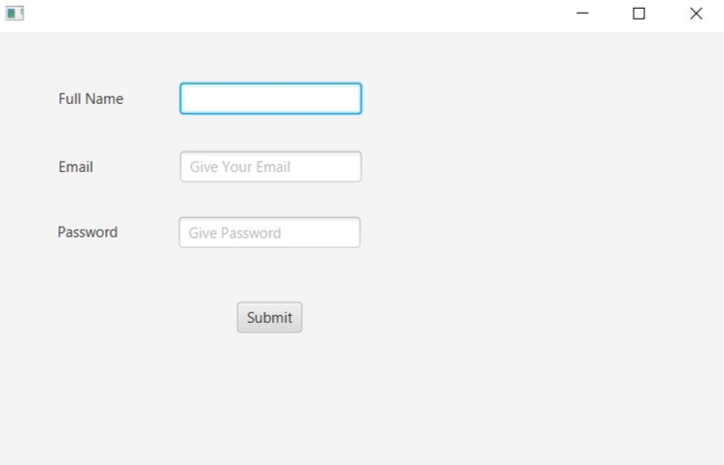
A Sample Interface Created by FXML to Give Inputs

Slide 33
Task flow
Database connection
Insert Query Prepare
Query Execution

Slide 34
References
https://www.youtube.com/watch
https://www.javatpoint.com/javafx-tutorial

